Slide 1
Monitoring particle and exosome count of cancer patient plasma pre-treatment

Slide 2
Ratio of Exosome After Wash/All particles from healthy and cancerous plasma

Slide 3
Ratio of Retained Exosome/Exosomes from healthy and cancerous plasma

Slide 4
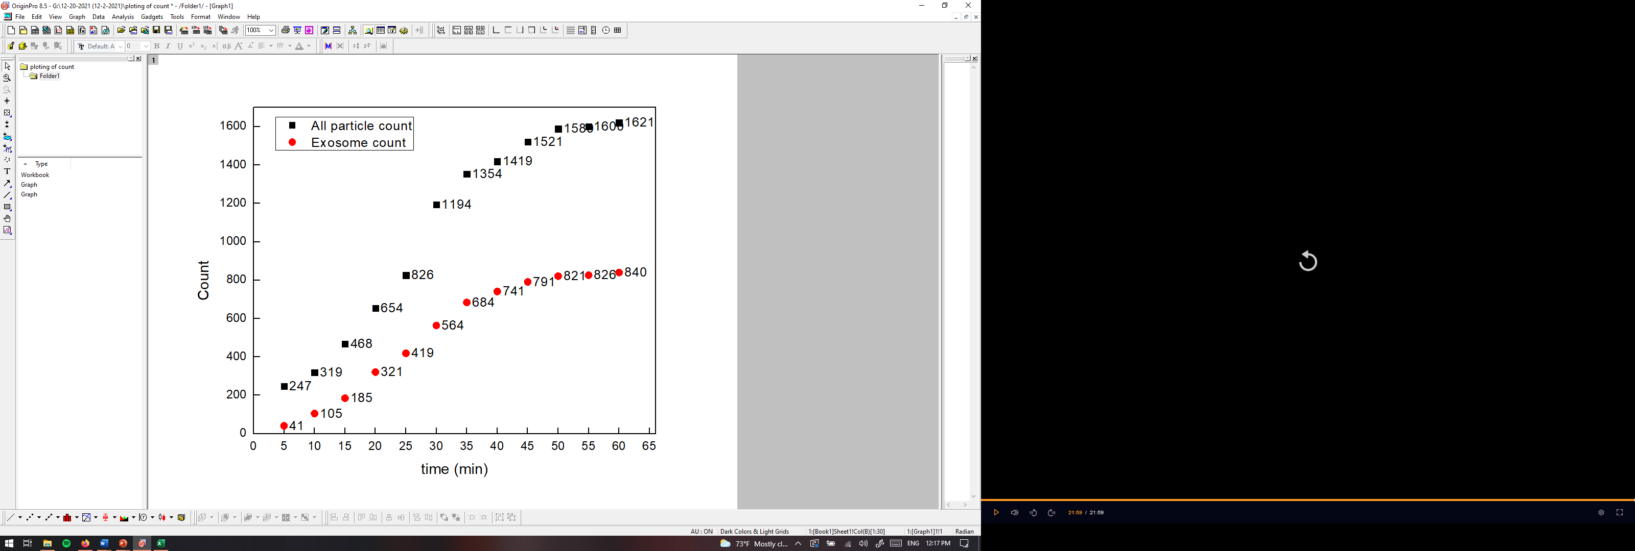
PANORAMA of Plasma Sample 12-2-21-2 (13A before treatment)
Time: 60 min
Count: 1621
Time: 60 min wash
Count: 195
Prediction: Looks Cancerous
Note: 21 % response to miRNA-21
Scale bar: 10 µm

Slide 5
Comparison of Plasma Particle Count After/Before Treatment
Plasma Sample | All | Large | Exosome all | Captured Exosomes | Based on Exosome Number After treatment
10 | 0.88832487 | 0.964349376 | 0.83618582 | 1.316923077 | Cancer
12 | 2.82644628 | 6.412587413 | 1.71645022 | 2.053738318 | Cancer (D)
13 | 0.0197409 | 0.008962868 | 0.0297619 | 0.056410256 | Healthy (A)
14 | 0.03956044 | 0.037946429 | 0.04060914 | 0.009020619 | Healthy relapsed
24 | 0.77443992 | 0.789038263 | 0.76028084 | 1.278931751 | Cancer (D)
260 | 0.05635148 | 0.017977528 | 0.08471761 | 0.033707865 | Healthy
280 | 0.96322942 | 1.427251732 | 0.71760391 | 2.008528785 | Cancer
300 | 0.27798861 | 0.314917127 | 0.25867052 | 0.030487805 | Healthy
745 | 0.6716 | 0.7048 | 0.6384 | 0.302476415 | Looks Cancerous (A)
823 | 2.52924791 | 2.790927022 | 2.29649123 | 0.904109589 | Cancer
825 | 0.88620342 | 3.852631579 | 0.57238307 | 2.260465116 | Cancer
827 | 1.52035831 | 1.970833333 | 1.23128342 | 2.246781116 | Cancer (Alive need more)
830E | 1.18181818 | 1.211267606 | 1.16421053 | 0.633375474 | Cancer
962 | 0.8373102 | 0.995 | 0.7164751 | 0.569444444 | Healthy (relapsed need more)
991 | 6.70605187 | 16.28985507 | 4.32733813 | 4.875 | Cancer (relapsed or D)
996 | 0.30163934 | 0.262820513 | 0.34228188 | 0.198529412 | Healthy
1001 | 0 | 0 | 0 | 0
1003E | 0.50970874 | 0.903508772 | 0.3590604 | 0.235294118 | Healthy (A)
1005 | 0.57575758 | 0.754385965 | 0.44 | 0.066666667 | Healthy (A)
1006 | 0 | 0 | 0 | 0
1009 | 0.31445783 | 0.918238994 | 0.17138599 | 0.027227723 | Healthy (A)
1013 | 0 | 0 | 0 | 0
1021 | 0 | 0 | 0 | 0
Note: Values below 1 are particle reduced in count.

Slide 6
Experimental Details for plasma post treatment 3 months later (12-2-21 set)
Used samples: 7, 8, 9, 10, 11, 12, 13, and 14
Plasma volume: 20 µl.
Type of Cancer: unknown.
Concentration: unknown.
Size Distribution: unknown.
Experimental duration: 60 min.
Antibody used: CD9, CD81, and CD63.

Slide 7
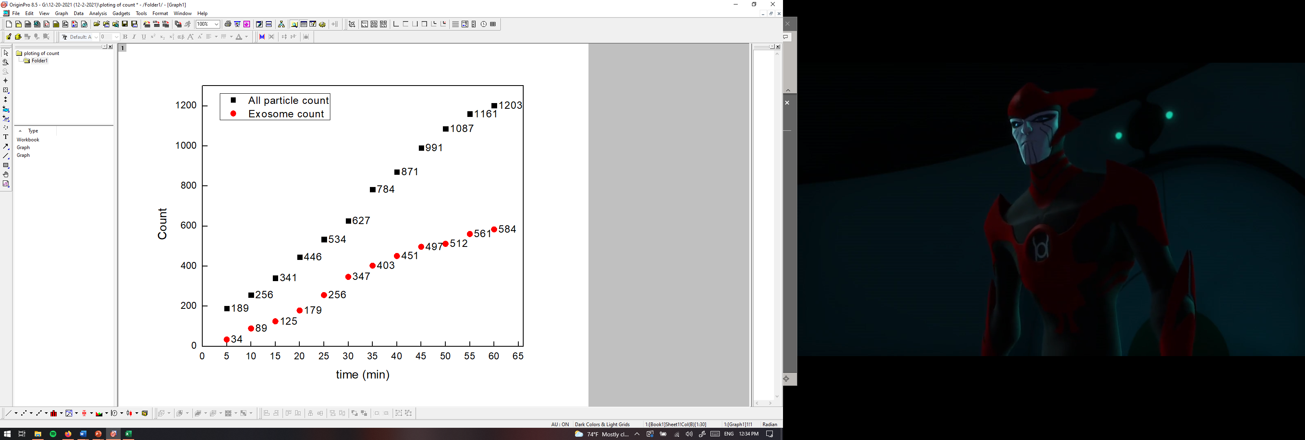

PANORAMA of Plasma Sample 12-2-21-7
Time: 60 min
Count: 1203
Time: 60 min wash
Count: 156
Prediction: Looks Cancerous; but lower end of the cancer range
Note: 9 % response to miRNA-21
Scale bar: 10 µm

Slide 8
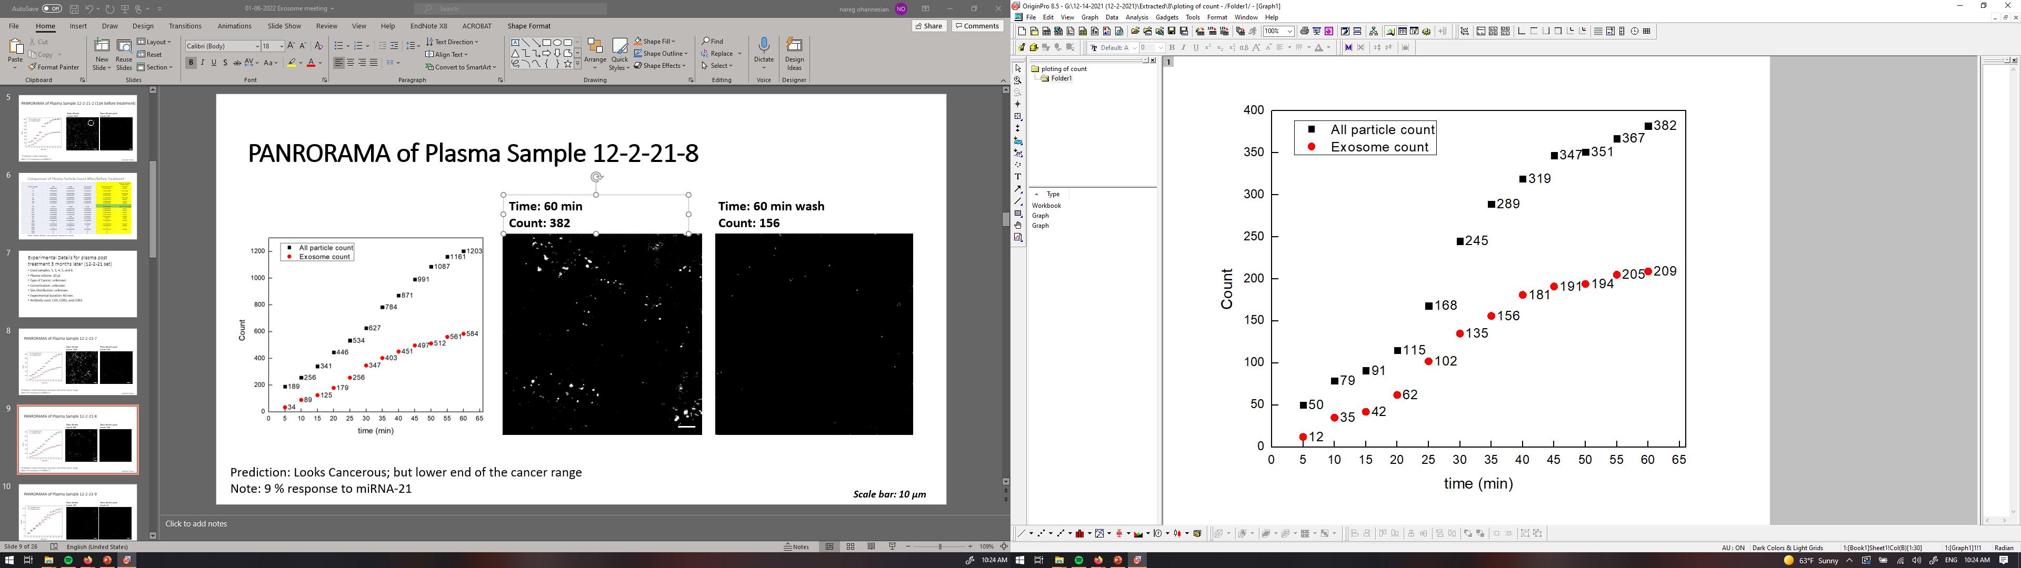
PANORAMA of Plasma Sample 12-2-21-8
Time: 60 min
Count: 382
Time: 60 min wash
Count: 31
Prediction: Looks Healthy
Note: 0 % response to miRNA-21
Scale bar: 10 µm

Slide 9
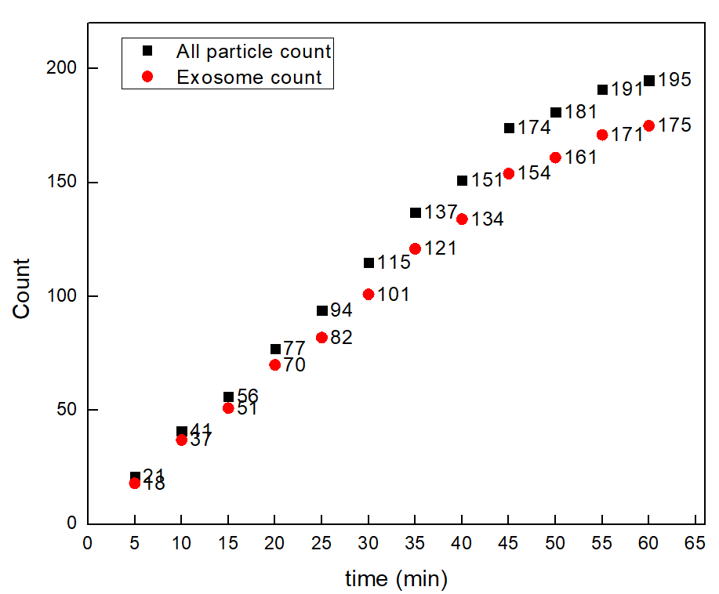


PANORAMA of Plasma Sample 12-2-21-9
Time: 60 min
Count: 195
Time: 60 min wash
Count: 31
Prediction: Looks Healthy
Note: 0 % response to miRNA-21
Scale bar: 10 µm

Slide 10
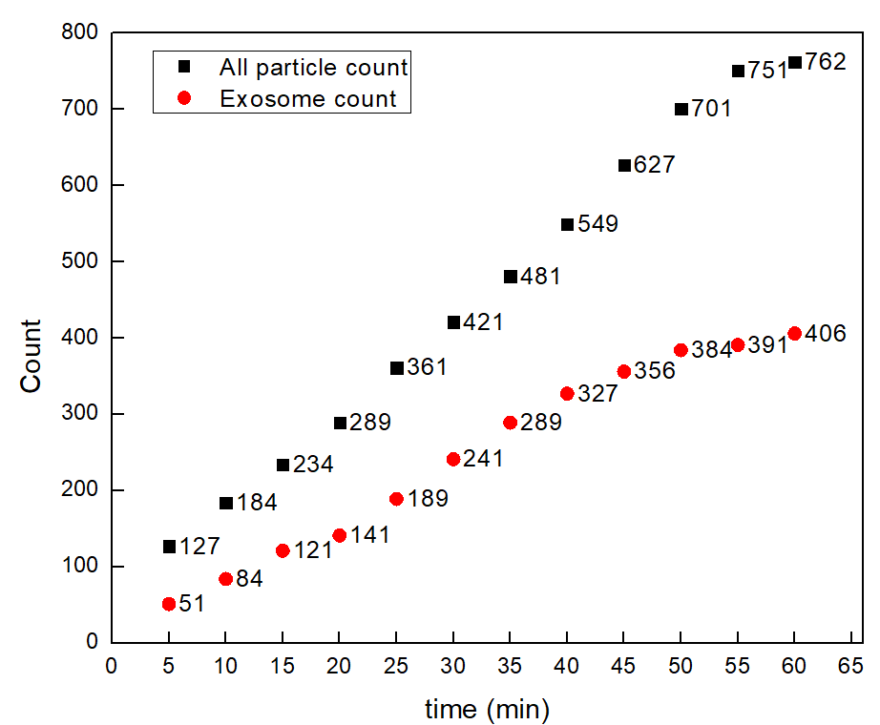


PANORAMA of Plasma Sample 12-2-21-10
Time: 60 min
Count: 762
Time: 60 min wash
Count: 200
Prediction: Looks Cancerous
Note: 0 % response to miRNA-21
Scale bar: 10 µm

Slide 11
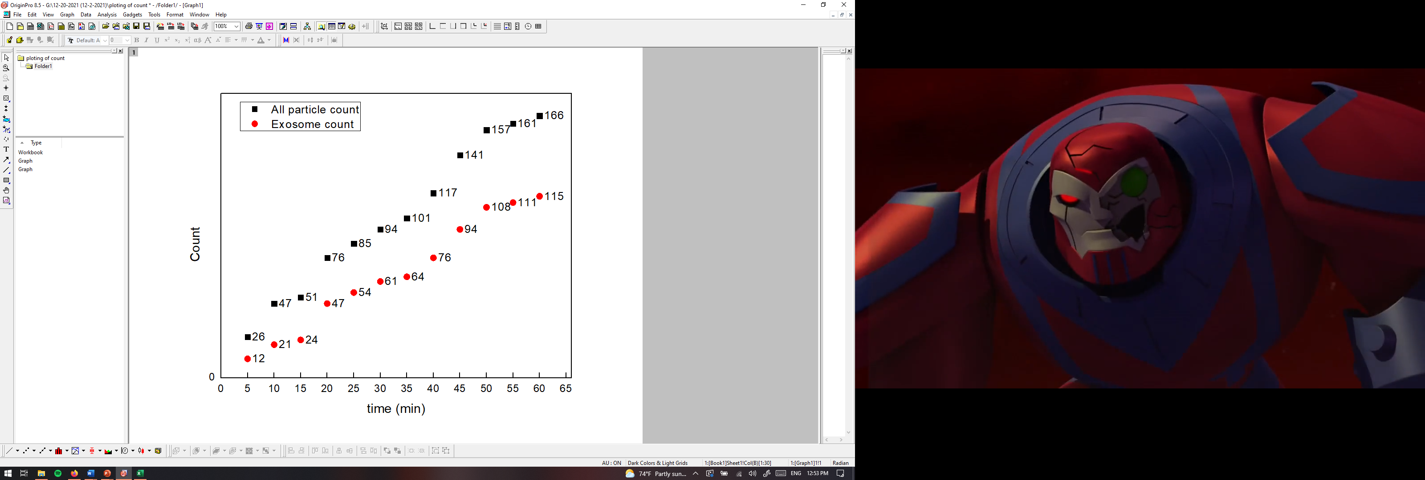
PANORAMA of Plasma Sample 12-2-21-11
Time: 60 min
Count: 166
Time: 60 min wash
Count: 61
Prediction: Looks Healthy; Slightly higher than normal range for captured exosomes
Note: 0 % response to miRNA-21
Scale bar: 10 µm

Slide 12
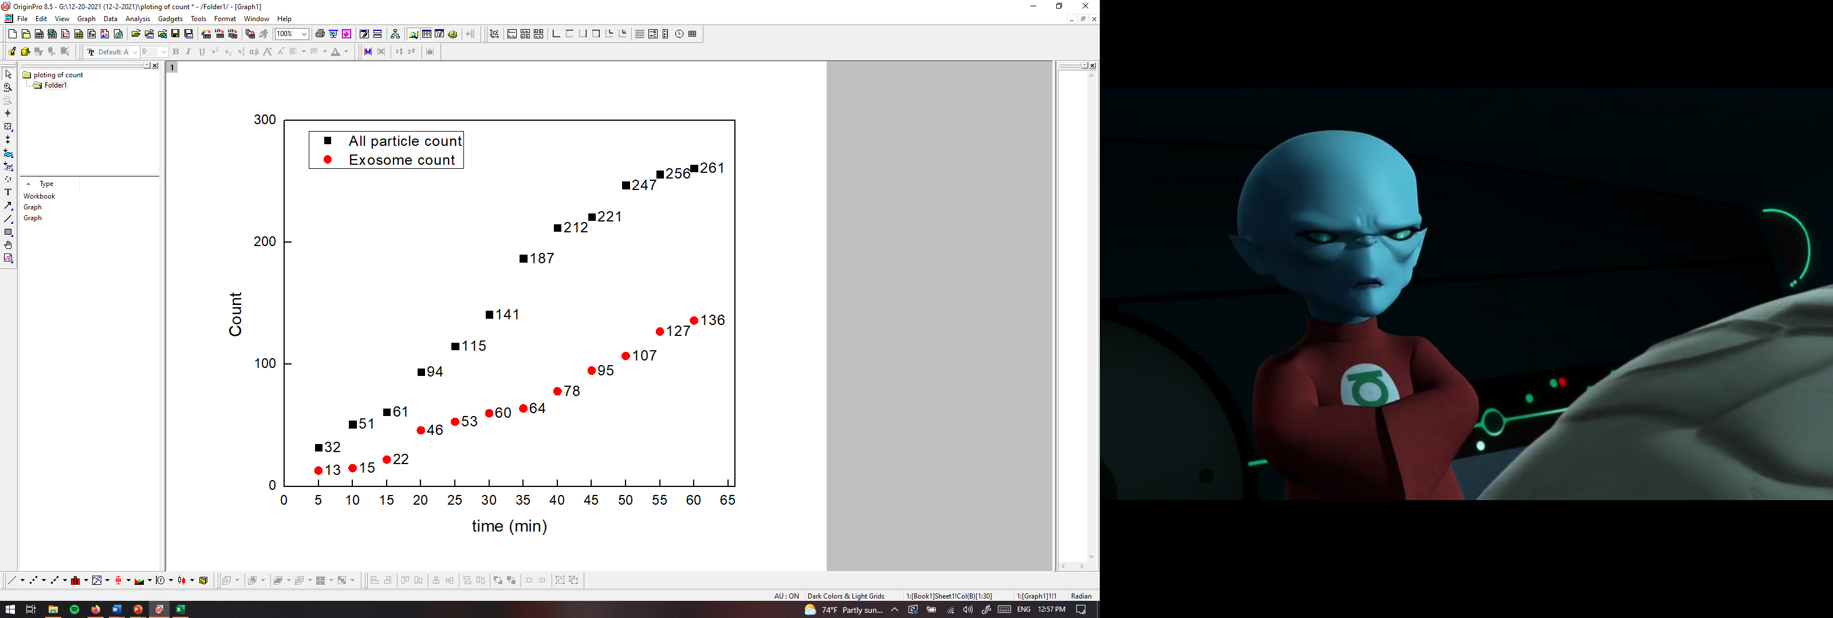

PANORAMA of Plasma Sample 12-2-21-12
Time: 60 min
Count: 261
Time: 60 min wash
Count: 69
Prediction: Looks Healthy; Slightly higher than normal range for captured exosomes
Note: 0 % response to miRNA-21
Scale bar: 10 µm

Slide 13
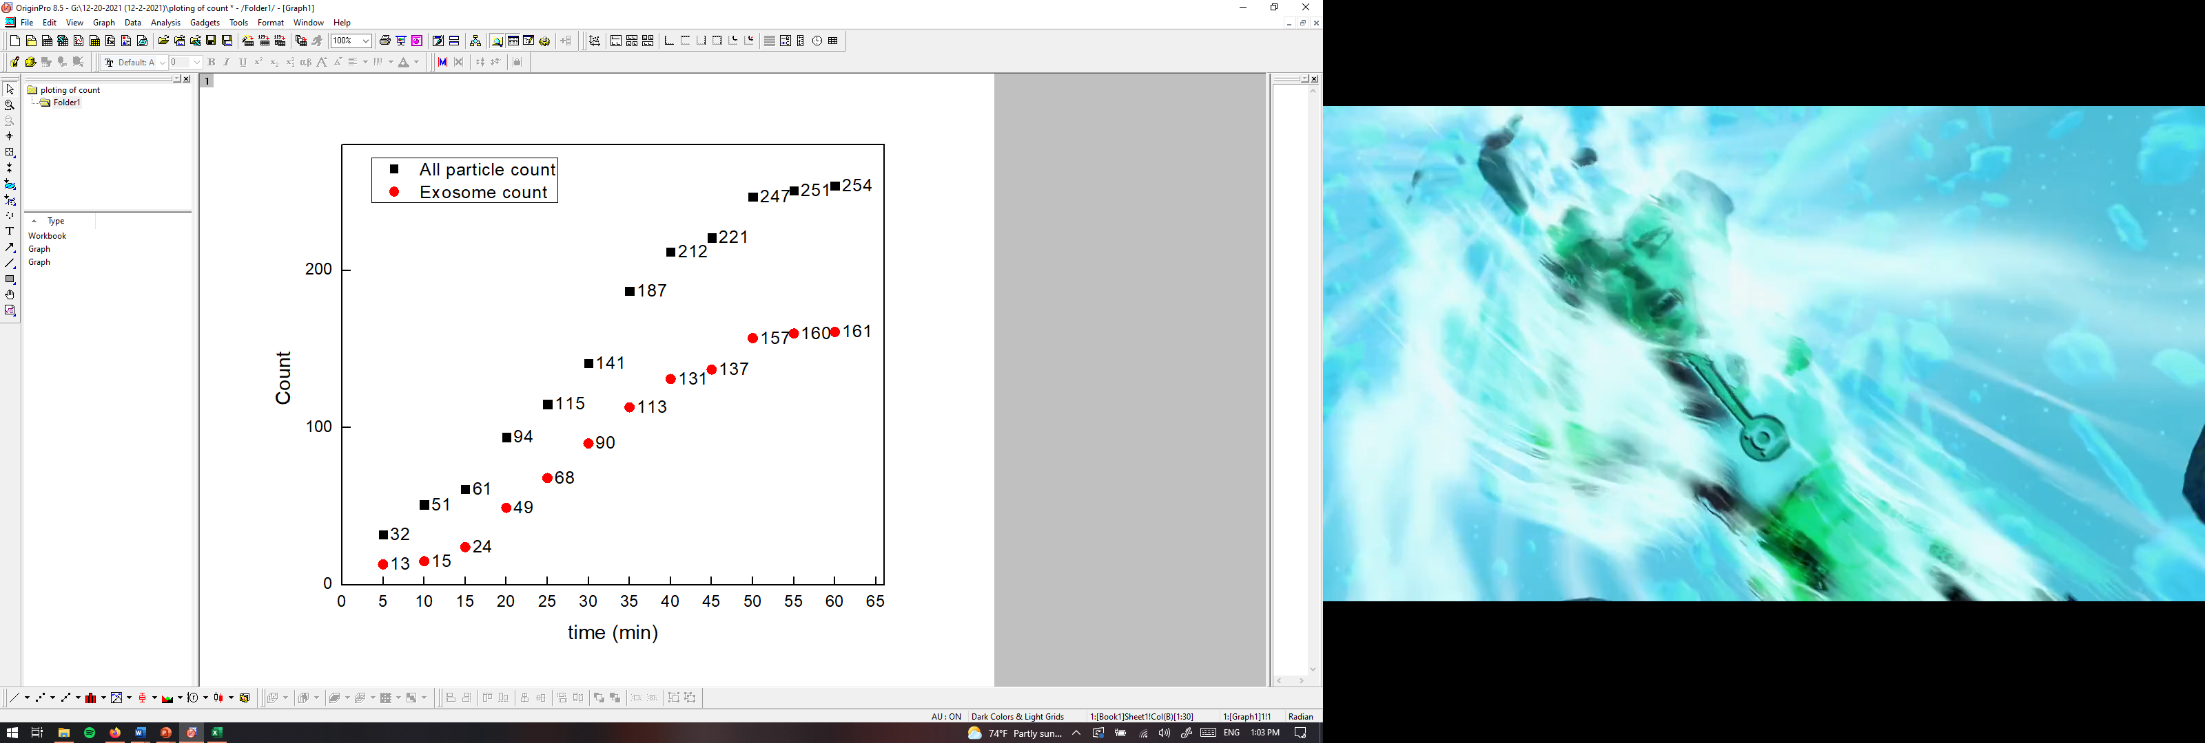

PANORAMA of Plasma Sample 12-2-21-13
Time: 60 min
Count: 254
Time: 60 min wash
Count: 56
Prediction: Looks Healthy; Slightly higher than normal range for captured exosomes
Note: 0 % response to miRNA-21
Scale bar: 10 µm

Slide 14
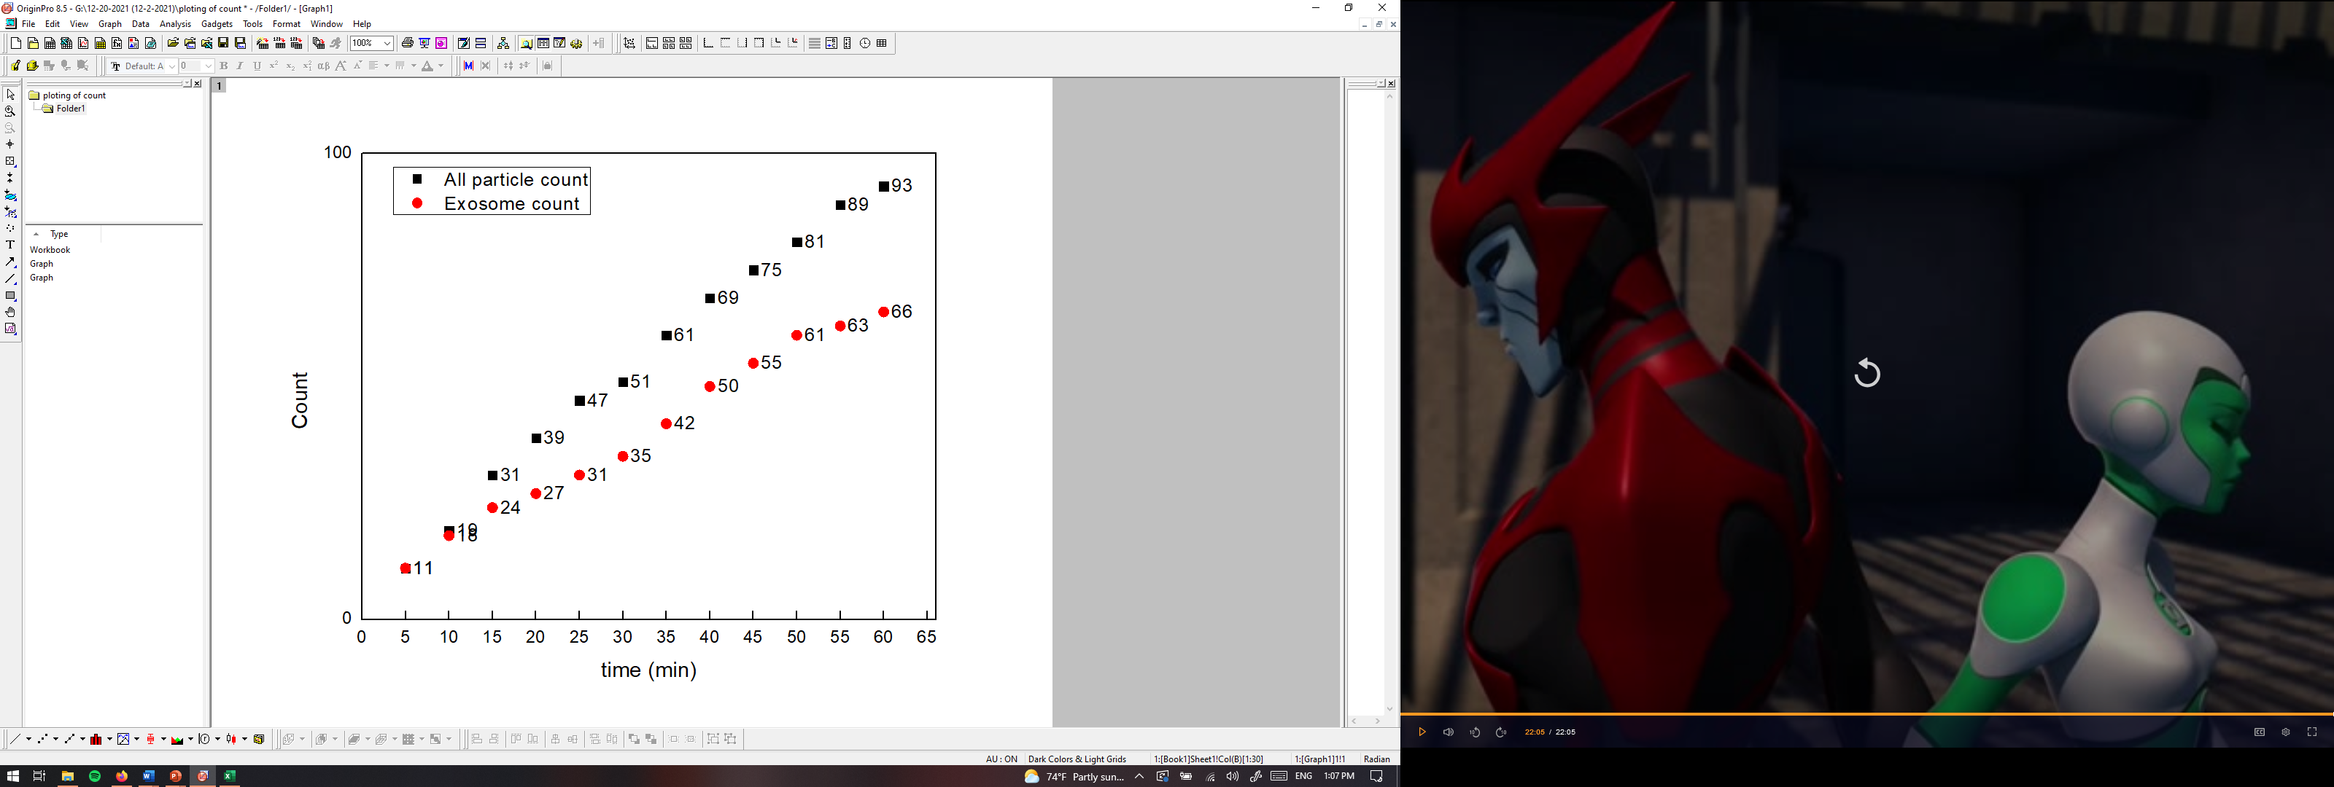
PANORAMA of Plasma Sample 12-2-21-14
Time: 60 min
Count: 93
Time: 60 min wash
Count: 28
Prediction: Looks Healthy;
Note: 0 % response to miRNA-21
Scale bar: 10 µm

Slide 15
Summary of particle count post treatment (3 months)
Sample (12-2-27) | 7 13E alive | 8 Alive 13F | 9 13G alive | 10 14F (relapsed) | 11 14G (maybe chemo) | 12 745F | 13 745G Alive | 14 (HCR 142)
Total Count | 1203 (584) | 382 (209) | 195 (175) | 762 (406) | 166 (155) | 261 (136) | 254 (161) | 93 (66)
Retained Exosomes | 156 | 31 | 31 | 200 | 61 | 69 | 56 | 28
Prediction | Cancer | Healthy | Healthy | Cancer | Healthy | Healthy | Healthy | Healthy

Slide 16
Experimental Details for plasma stage one lung cancer
Used samples: 7A, 8A, 9A, and 11A
Plasma volume: 20 µl.
Type of Cancer: unknown.
Concentration: unknown.
Size Distribution: unknown.
Experimental duration: 60 min.
Antibody used: CD9, CD81, and CD63.

Slide 17
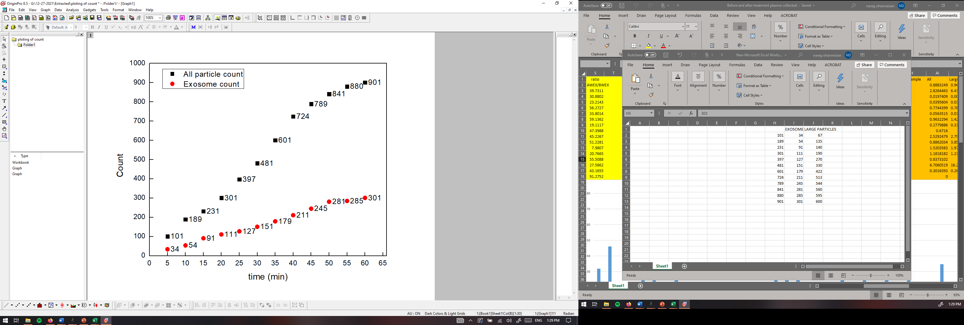
PANORAMA of Plasma Sample 0737-7A
Time: 60 min
Count: 901
Time: 60 min wash
Count: 135
Note: Before wash count matches the CI of stage 3 (500-1200)
After wash count lower than the CI for stage 3 (155-304)
Note: 0 % response to miRNA-21
Scale bar: 10 µm

Slide 18
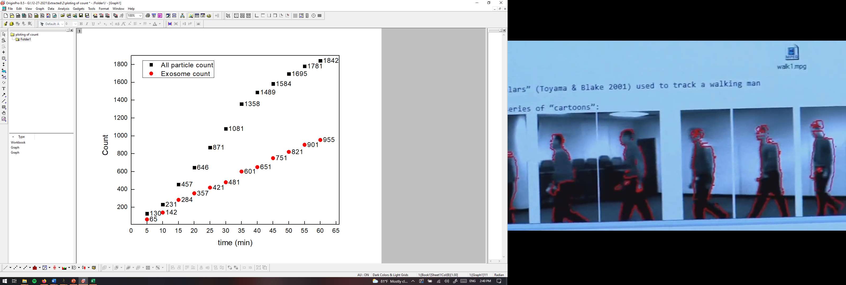
PANORAMA of Plasma Sample 0737-8A
Time: 60 min
Count: 1842
Time: 60 min wash
Count: 221
Note: Before wash count above the CI of stage 3 (500-1200)
After wash count matches the CI for stage 3 (155-304)
Note: 0 % response to miRNA-21
Scale bar: 10 µm

Slide 19
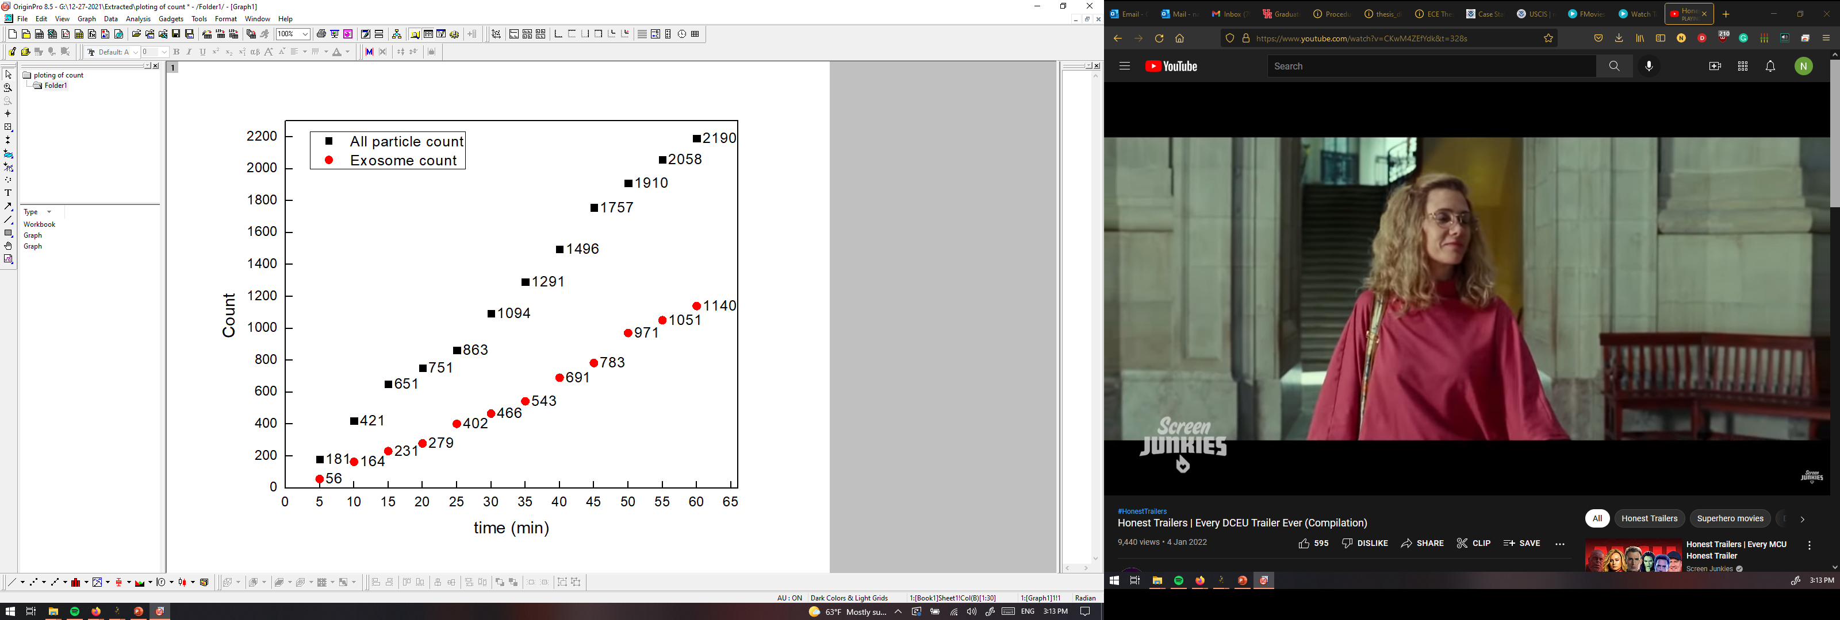
PANRORAMA of Plasma Sample 0737-9A
Time: 60 min
Count: 2190
Time: 60 min wash
Count: 454
Note: Before wash count above the CI of stage 3 (500-1200)
After wash count above the CI for stage 3 (155-304)
Note: 3 % response to miRNA-21
Scale bar: 10 µm

Slide 20
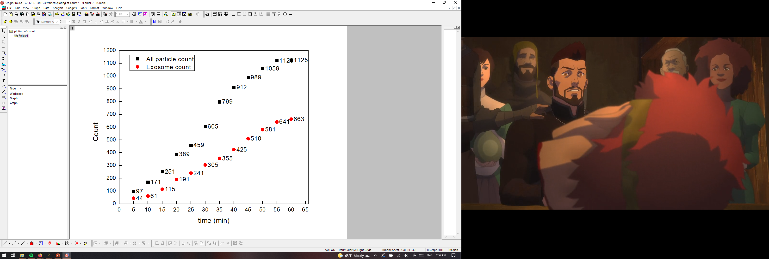
PANRORAMA of Plasma Sample 0737-11A
Time: 60 min
Count: 1125
Time: 60 min wash
Count: 333
Note: Before wash count match the CI of stage 3 (500-1200)
After wash count match the CI for stage 3 (155-304)
Note: 0 % response to miRNA-21
Scale bar: 10 µm

Slide 21
Experimental Details for plasma Esophagus Cancer
Used samples: 353A, 354, 371, 389A, 397A, 434A, 440A, 447A, and 451A
Plasma volume: 20 µl.
Type of Cancer: unknown.
Concentration: unknown.
Size Distribution: unknown.
Experimental duration: 60 min.
Antibody used: CD9, CD81, and CD63.

Slide 22
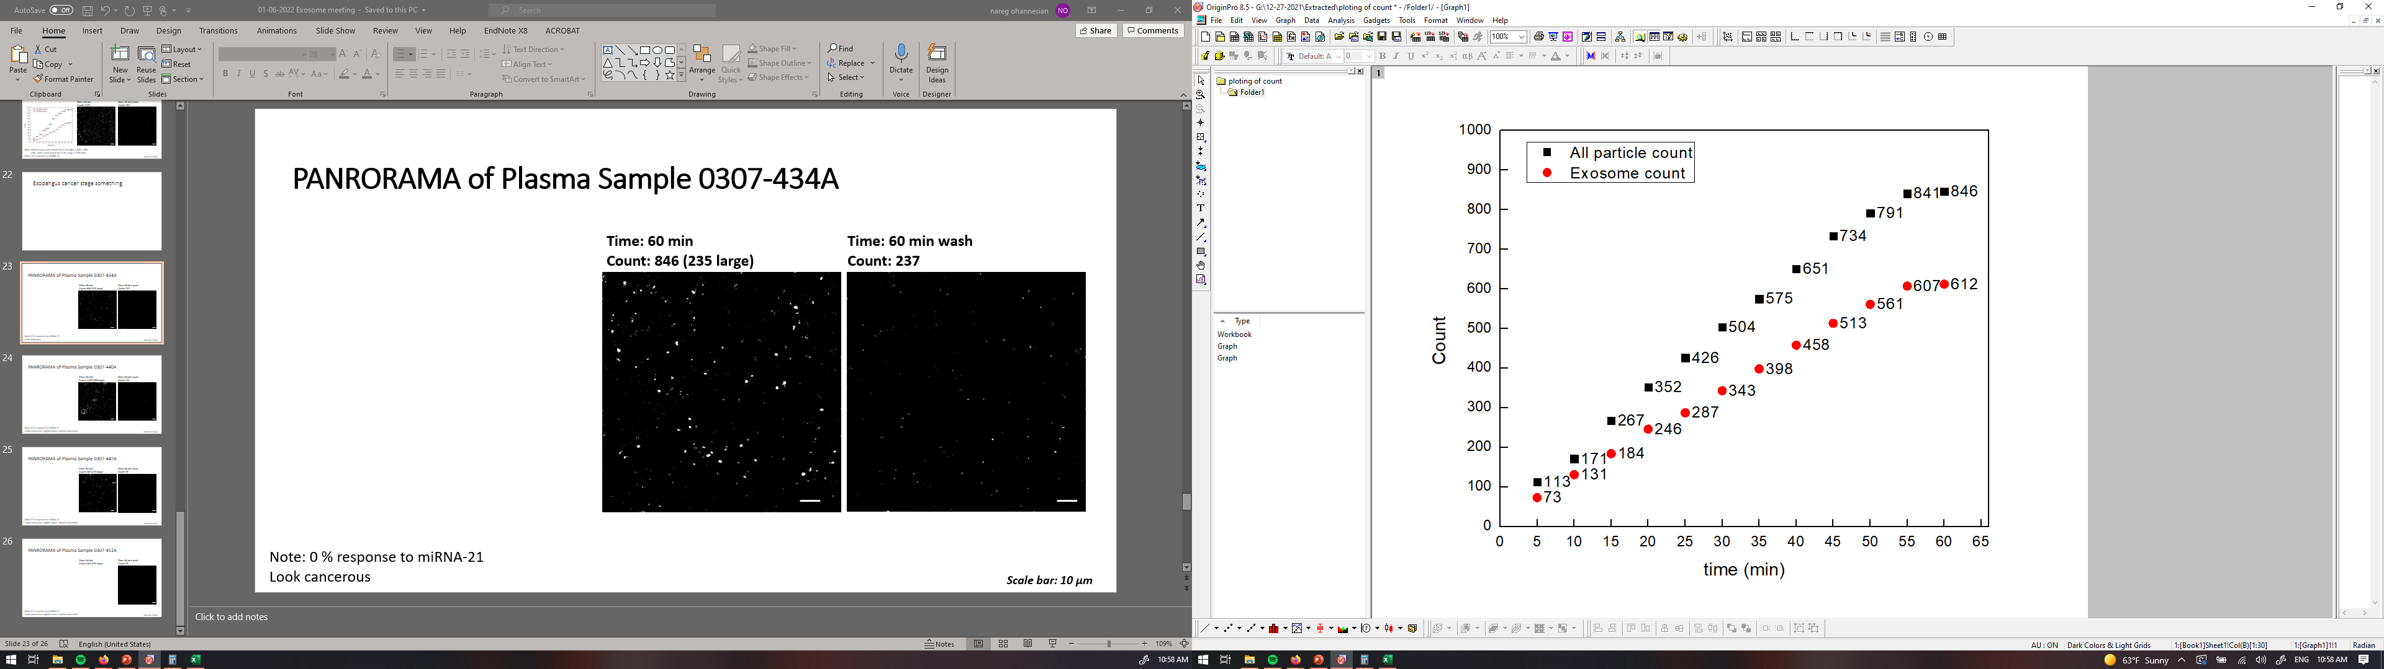
PANRORAMA of Plasma Sample 0307-434A
Time: 60 min
Count: 846
Time: 60 min wash
Count: 237
Note: 0 % response to miRNA-21
Look cancerous
Scale bar: 10 µm

Slide 23

PANORAMA of Plasma Sample 0307-440A
Time: 60 min
Count: 1105
Time: 60 min wash
Count: 131
Note: 0 % response to miRNA-21
Looks cancerous; slightly lower retained exosomes.
Scale bar: 10 µm

Slide 24
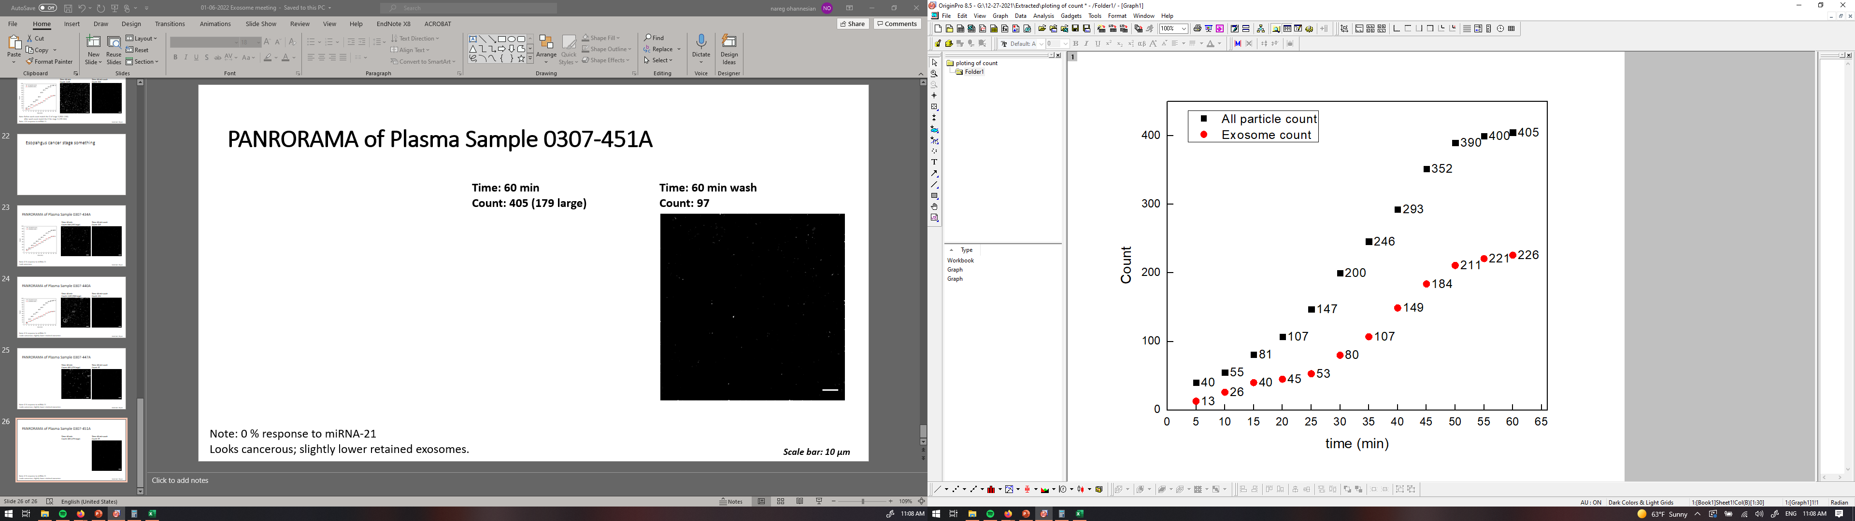
PANORAMA of Plasma Sample 0307-447A
Time: 60 min
Count: 405
Time: 60 min wash
Count: 107
Note: 0 % response to miRNA-21
Looks cancerous; slightly lower retained exosomes.
Scale bar: 10 µm

Slide 25
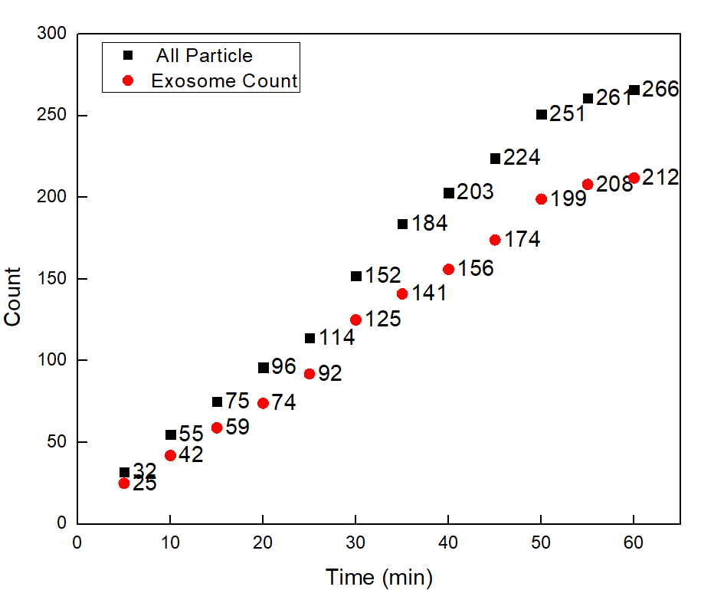


PANORAMA of Plasma Sample 0307-451A
Time: 60 min
Count: 266
Time: 60 min wash
Count: 161
Note: 0 % response to miRNA-21
Looks cancerous; Low number of large vesicles but retained exosomes are within cancer range.
Scale bar: 10 µm

Slide 26
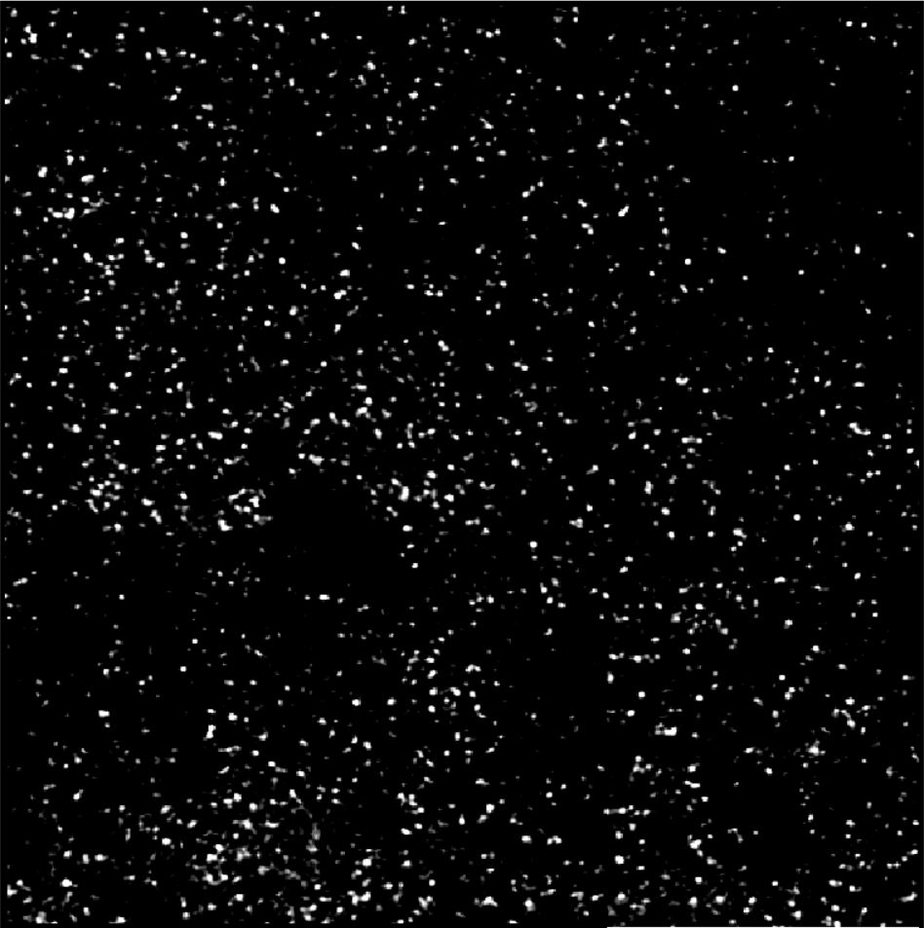
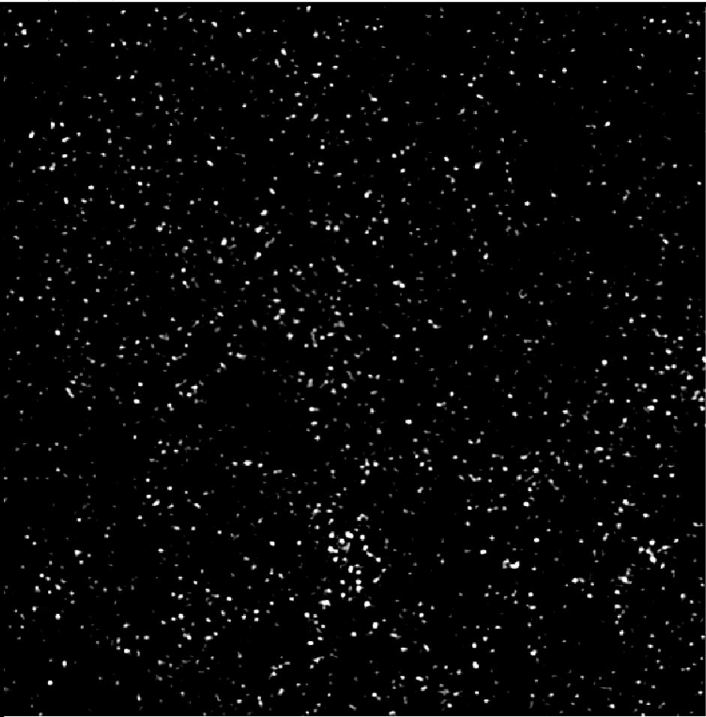
Image of Detected Particles via PANORAMA (307-389A)
Before Wash
Number of Particles detected: 1207
After Wash
Number of Particles detected: 1089
Scale Bar: 10 µm

Slide 27
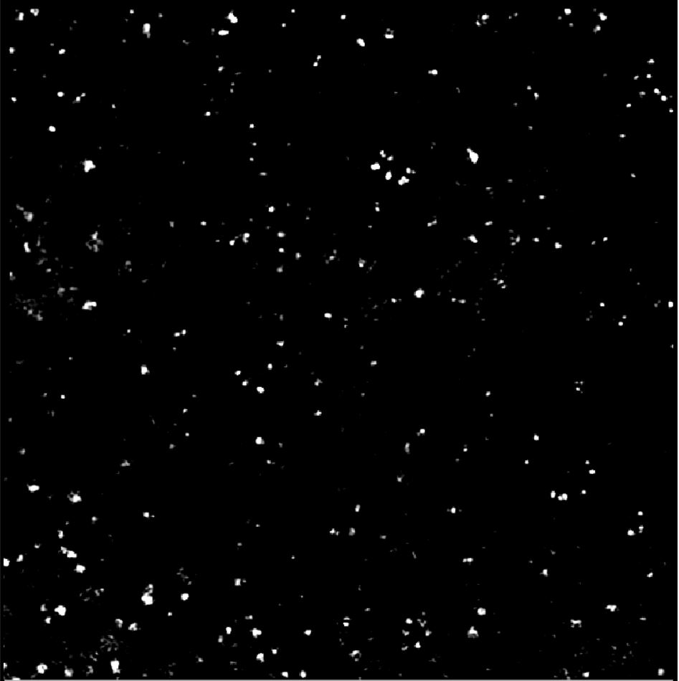
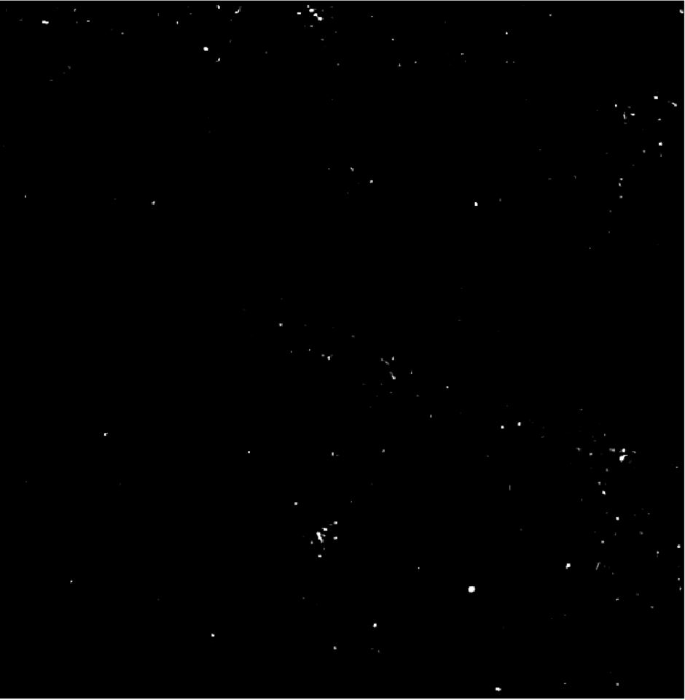
Image of Detected Particles via PANORAMA (307-397A)
Before Wash
Number of Particles detected: 429
After Wash
Number of Particles detected: 82
Scale Bar: 10 µm

Slide 28
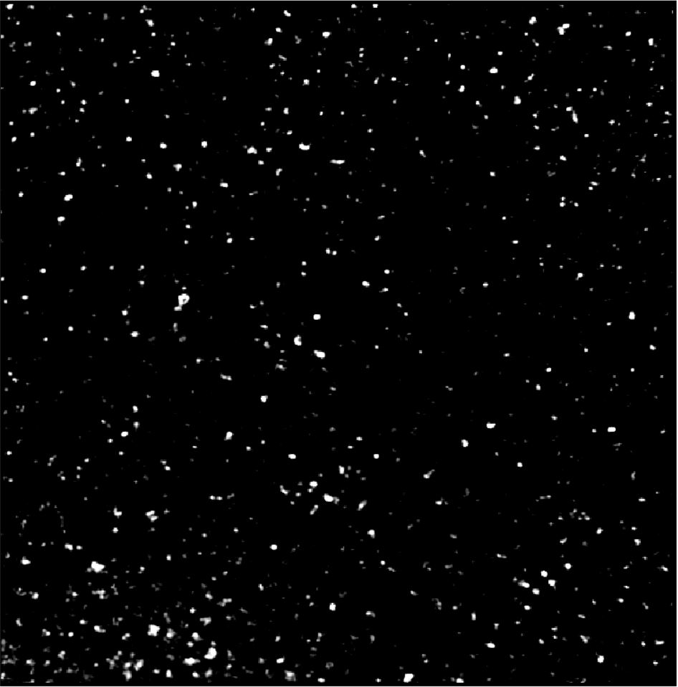
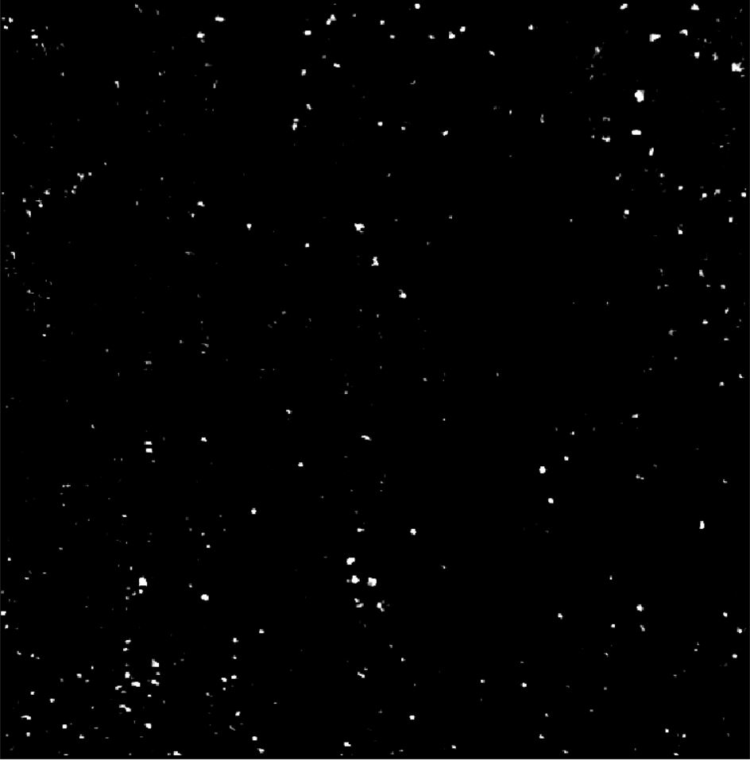
Image of Detected Particles via PANORAMA (307-371A)
Before Wash
Number of Particles detected: 516
After Wash
Number of Particles detected: 253
Scale Bar: 10 µm

Slide 29
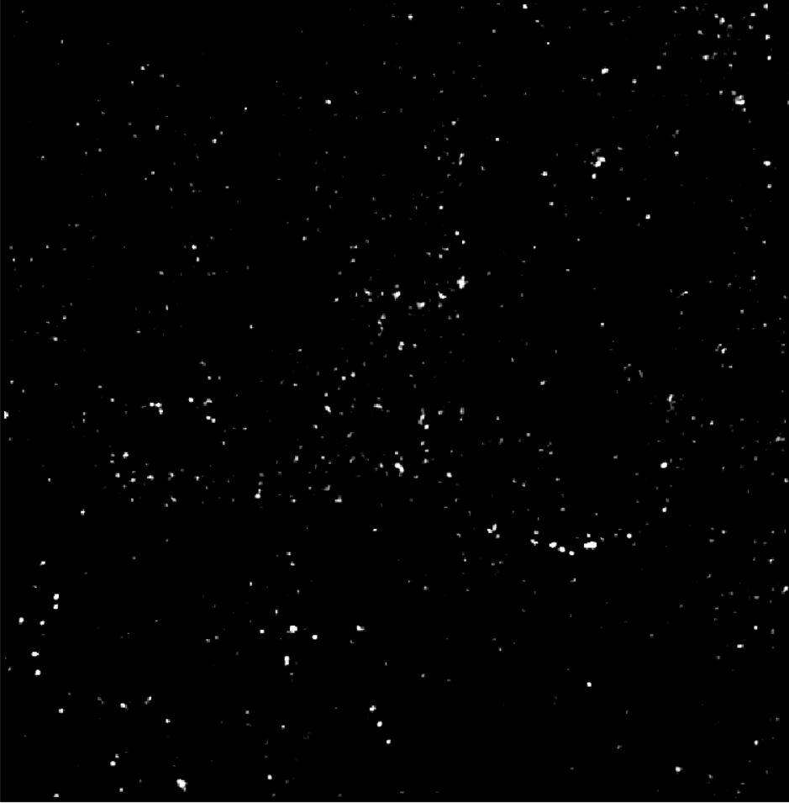

Image of Detected Particles via PANORAMA (307-353A)
Before Wash
Number of Particles detected: 383
After Wash
Number of Particles detected: 115
Scale Bar: 10 µm

Slide 30
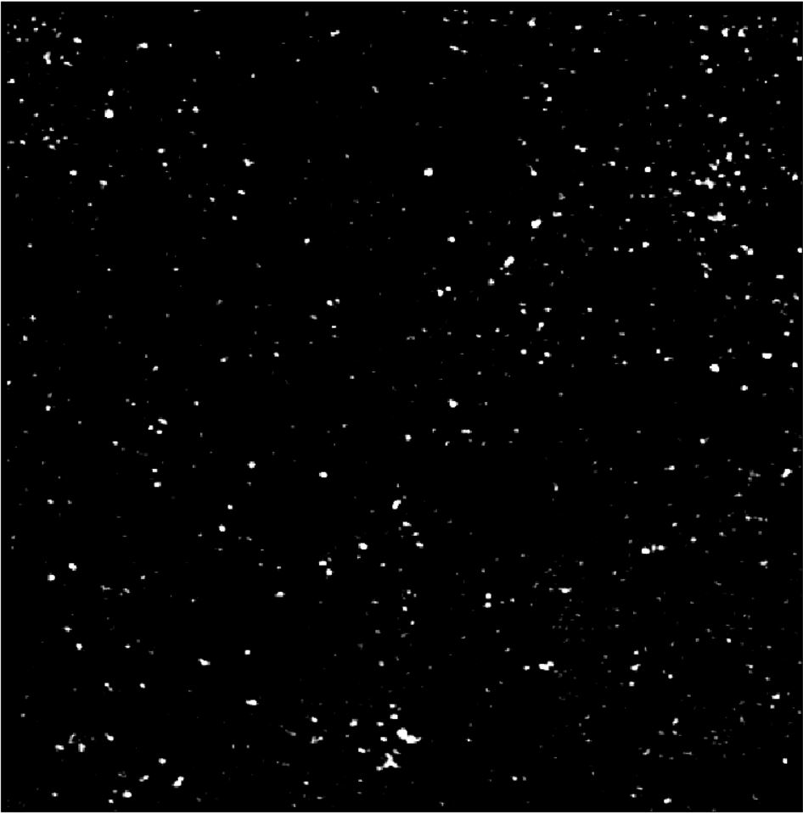
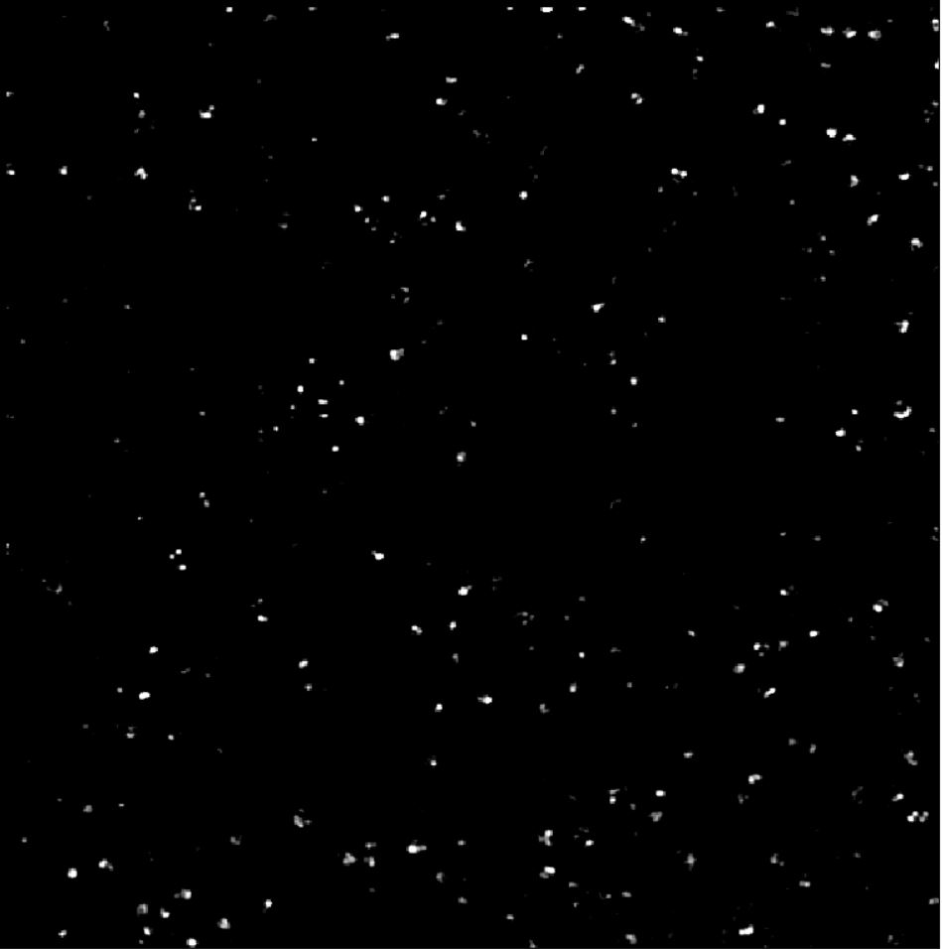
Image of Detected Particles via PANORAMA (307-354A)
Before Wash
Number of Particles detected: 411
After Wash
Number of Particles detected: 229
Scale Bar: 10 µm

Slide 31
Summary
Sample Name | Before Wash Count | After Wash Count | Retention Rate (%)
0307-389A | 1207 | 1089 | 90.22
0307-397A | 429 | 82 | 19.11
0307-353A | 383 | 115 | 30.03
0307-354A | 411 | 229 | 55.7
0307-371A | 516 | 253 | 49.03
0307-434A | 846 | 237 | 28
0307-440A | 1105 | 131 | 11.85
0307-447A | 405 | 105 | 25.92
0307-451A | 266 | 161 | 60.52
Healthy Plasma Exosome Range is [5-40]

